Slide 1
Flush height between LCD and
panel main NG
Contents
1. Define
2. Measurement
3. Analyze
4. Improvement
5. Control
6 Sigma GB Assignment
IVI LD2 Hoang Xuan Huong

Slide 2
Six Sigma Project Register
Task category
□ HW □ SW
■ Mecha □ Current job
Team | IVI LD2
Leader | Dao Cong Sang
Owner | Hoang Xuan Huong
Theme | Model JLR EMA FCD Flush height between LCD and panel main NG |  |  |  | Period | ’25.04.06~’25.06.19 |  | Task team name | IVI LD Mechanic
Six Sigma Project |  | Improvement Goal (Stretch Goal) |  |  |  |  |  | Idea of breaking the limit
 |  | Improvement index |  | Current |  | World Best | Goal
Reduce Flush between LCD and panel main |  | KPI | Defect rate | 500,529 (ppm) |  | NA | 0ppm | - Make ES sample to verify in line - Request supplier modify mold to control height dimension of panel main
 |  | ProjectY | Flush -0.4~0 mm | Cpk=0.28 Z=0.84 |  | NA | Cpk ≥1.33 Z=4.5
Management Issue (Biz.Issue) |  | Implement Plan (Fast & Strong) |  |  |  |  |  | Task Member
This issue has been around for a long time, and the failure rate is very high at 500,529 ppm, so we waste time to rework and rework fee
 |  |  |  |  |  |  |  | Location
 |  |  |  |  |  |  |  | LG Electronics Viet Nam-Hai Phong
Qualitative Performance |  | Quantitative Performance |  |  |  |  |  | Neck Point
After this theme, I have opportunity and experience make 6 sigma report for green belt. This is the first time I have made a report like this, so I cannot avoid some shortcomings. I look forward to your comments and support. |  | After this theme, I can save loss time: Before defect rate: 500,529 ppm → EST: Loss time and rework fee (70$ - sample price) After defect rate: 0 ppm → Improve issue Total save cost: 70$*500=35000$ |  |  |  |  |  | Dimension not mention in drawing
❑ Schedule
Team | Name | Role
LD | Huong | Leader
SQA | Hieu | Member
ME | Cuong | Member
PE | Vinh | Member
PD | Hoan | Member
6/1
6/15
6/30
7/12
7/30
D
M
A
I
C
Key activity / Output
D : Define issue, Define defect rate, Collect defective sample
M : Gage R&R evaluate equipment and inspector measurement skills
A : Use Fish bones analysis method to find root cause
I : Meeting discuss, make improvement action plan and follow up
C : Verify action on line, Set up quality meeting to control this issue
Notes:
2

Slide 3
1.1 Yy break down
Define
Measure
Analyze
Improve
Control
Big Y
Little y1
Little y2
Little y3
Activity
PIC
Reduce EMA FCD Defect rate
Mecha defect
Assembly issue
Flush issue
6 Sigma assignment
LD Mec
837,005 PPM
(xx/xxxEA
Jun~Aug Y26)
76.3% 638,634 PPM
69.4% 580,882 PPM
59.8% 500,529 PPM
Appearance issue
Gap issue
Material defect → return to supplier
Seojin supplier
6.9% 251 PPM
8.0% 500,529 PPM
Press issue
Machine issue
PE
1.6% 80,353 PPM
Hardware defect
Vision inspection
OK/NG
Broken pin connector _ check PCBA
4P
7.8% 65,286 PPM
Sorfware defect
Uniformity Function
Black Uniformity value
Improve software
HQ R&D
15.9% 13,083 PPM
Function issue
Sleep curent
Improve program
HQ R&D
Before
837,005 PPM
After
336,467 PPM
Most of hardware issue cause by foreign material inside the set or camera detect wrong position after assembly process, cable, connector need to improve by PE/Supplier
Function issue will be solved by HQ R&D
Asemble issue from material, design of mechanic parts not optimize, that’s why I choose this issue for my 6 sigma assignment.
Decrease defect rate of
JLR EMA FCD

Slide 4
1.2 Pareto
Define
Measure
Analyze
Improve
Control
Add pareto
80:20
Giải thích 80%
Item PICxx
MFG xxx

Slide 5
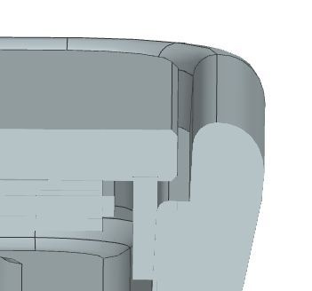
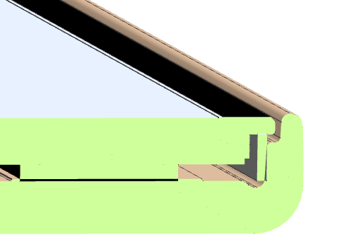
1.2 Define project Y
Define
Measure
Analyze
Improve
Control
To reduce the flush between LCD and Panel main, Project Y is formed :“Flush “
Flush (height) is the distance from the glass surface to the heightest point of the panel main
Probe measurement
Panel main
Glass
Flush (height)
Flush
Chi tiết
3D

Slide 6
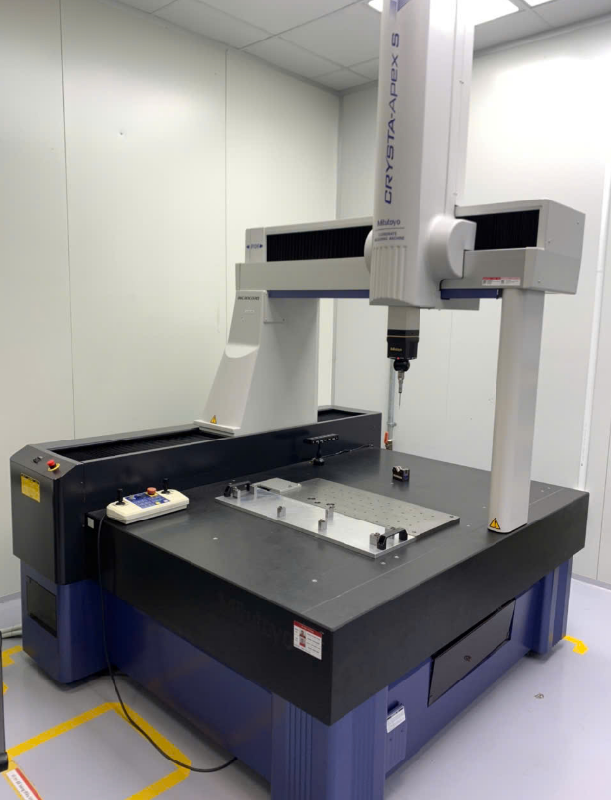
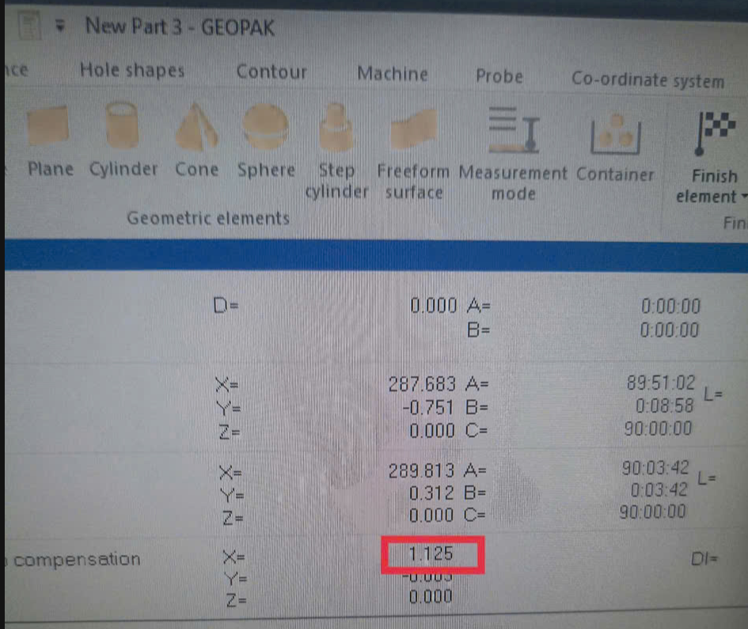
1 Preparation of Gage R&R
Define
Measure
Analyze
Improve
Control
Model: JLR EMA FCD
Part name: Panel main
Measure System
How to get sample (sampling)
Equipment: CMM (coordinate measurement machine) Mitoyoto
Resolution: 0.001 mm
Sample Selection:
Type 1: 1 people measure a sample, measure repeat 30 times
Type 2: 3 operators measure 10 samples, measure repeat 3 times (Blind and random)
A sample which contains the entire spec or the dispersion of the process should be selected
- Normally ± 10 to 20% is recommended, but it should be selected considering the current state of the goods in stock!
- The choice of sample should reflect the state of the process
- Pick NG/OK samples, including sample near spec.
Resolution
4. Blind test: The measurer should not know the information of the
sample to be measured, including the specifications.
5. Random: The measuring sequence of the measurer and the sample to be measured and the repetition are determined randomly

Slide 7
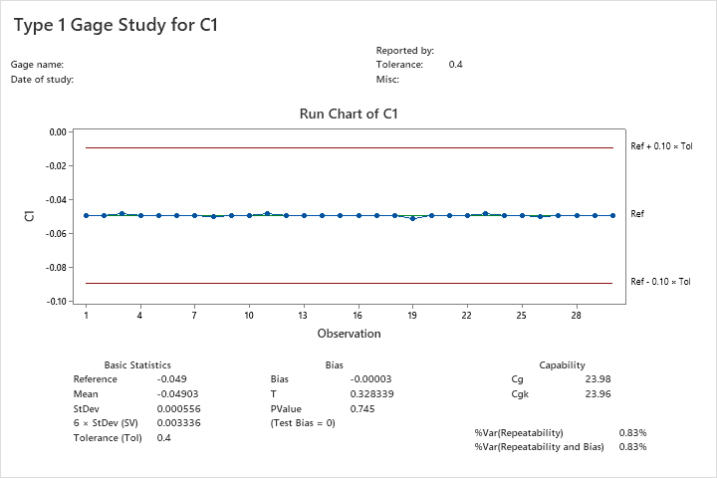
2 Result of Gage Study
Measure
Define
Analyze
Improve
Control
2.1 Type 1 Study
Date | 18.June.2025 | Equip | CMM | Target | -0.2
Part no | ABA30132601 | ID | IVI-SQA | +TOL | +0.2
Part name | Bracket Mid Assy | Resolution | 0.001mm | -TOL | -0.2
Reference Value | -0.049
Operator | Long
Time | Data
1 | -0.049
2 | -0.049
3 | -0.048
4 | -0.049
5 | -0.049
6 | -0.049
7 | -0.049
8 | -0.05
9 | -0.049
10 | -0.049
11 | -0.048
12 | -0.049
13 | -0.049
14 | -0.049
15 | -0.049
16 | -0.049
17 | -0.049
18 | -0.049
19 | -0.051
20 | -0.049
21 | -0.049
22 | -0.049
23 | -0.048
24 | -0.049
25 | -0.049
26 | -0.05
27 | -0.049
28 | -0.049
29 | -0.049
30 | -0.049
Result:
- StDev: 0.0006
- Tolerance: 0.1
6xStDev (SV): 0.0033
Capability
- Cg: 23.98 > 1.33
Cgk: 23.96> 1.33
Choose 1 QC member who skill well, measure 1 part 30 times same measure method to verify the measurement system, look at chart,
we see “Resolution: 0.001<5% of Tol ” → Resolution of equipment is OK, Cg, Cgk >1.33 (OK)
Conclusion: Equipment is OK and can use to measure and analysis.
Notes:
1. How to process Type I? We need to measure 30 times for one sample which reference value is known
How to choose Sampling? Chọn mẫu như thế nào? Just choose random sample and know the reference value-
1 mẫu ngẫu nhiên biết trước reference value
2. How to get the reference value? Làm sao để có reference value? –
There are two ways: Hai cách:
- First: Use equipment has high precision (accuracy) Sử dụng thiết bị đo chính xác cao.
- Second: Measure one sample 10 times with equipment has high precision then get mean (average) of these measured values. Đo lặp lại part 10 lần với 1 dụng cụ đo chính xác, sau đó lấy trung bình
3. Cg, Cgk là gì? Cg and Cgk are Measuring capacity index of measuring equipment --- Chỉ số năng lực đo đạc của thiết bị đo Tiêu chuẩn: Cg, Cgk >=1.33 4.
Phân biệt giữa Cg vs Cgk? Cg is used when target and data mean are the same, Cgk is used in case target and data mean is not the same.
5. Công thức của Cg &Cgk? Cp and Cpk are called Process Capability. Pp and Ppk are called Process Performance The index takes into consideration the fact that your data is maybe not centered.
How many method to select sample? Simple random Stratified Systematic Cluster Combination Tiêu chuẩn resolution <5% lấy đâu ra? –Based on the standard of GM, Bosch, VDA 5 The acceptance criteria are less than 5% in GM, Bosch, … and less than 10% in AIAG, so the resolution of the instrument is satisfactory. Tolerance=T=USL-LSL %RE=RE/T

Slide 8
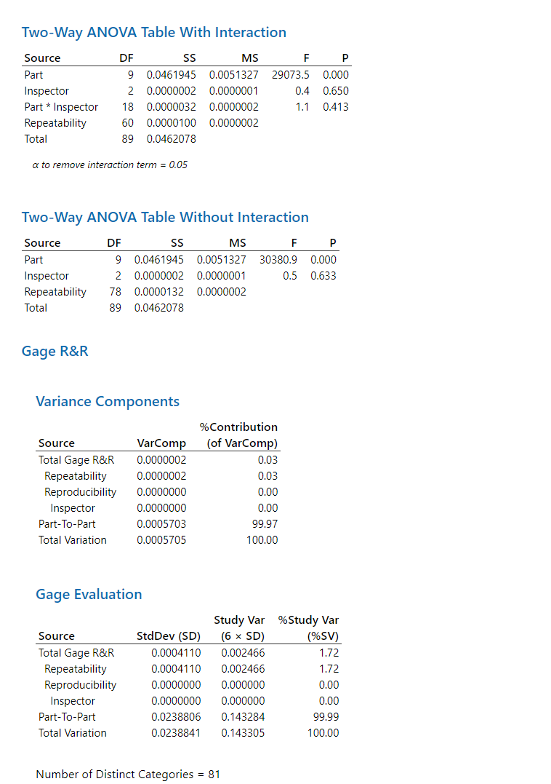
2 Result of Gage Study
Measure
Define
Analyze
Improve
Control
2.2 Type 2 study
Date | 18.Oct.2024 | Ruler | CMM | Target | 2.7
Part no | ABA30132601 | ID | IVI-SQA | +TOL | +0.05
Part name | Bracket Mid Assy | Resolution | 0.01mm | -TOL | -0.05
 | Huong |  |  | Long |  |  | Phuc
 | Time 1 | Time 2 | Time 3 | Time 1 | Time 2 | Time 3 | Time 1 | Time 2 | Time 3
1 | 0.024 | 0.024 | 0.024 | 0.024 | 0.024 | 0.025 | 0.024 | 0.025 | 0.024
2 | -0.002 | -0.002 | -0.001 | -0.002 | -0.002 | -0.003 | -0.002 | -0.002 | -0.002
3 | 0.022 | 0.022 | 0.022 | 0.023 | 0.022 | 0.023 | 0.022 | 0.023 | 0.022
4 | 0.024 | 0.024 | 0.024 | 0.024 | 0.024 | 0.025 | 0.024 | 0.025 | 0.024
5 | -0.022 | -0.022 | -0.021 | -0.022 | -0.022 | -0.022 | -0.022 | -0.022 | -0.022
6 | 0.022 | 0.022 | 0.022 | 0.023 | 0.022 | 0.023 | 0.022 | 0.023 | 0.022
7 | 0.027 | 0.027 | 0.028 | 0.027 | 0.028 | 0.027 | 0.027 | 0.027 | 0.027
8 | 0.021 | 0.021 | 0.021 | 0.021 | 0.021 | 0.022 | 0.021 | 0.021 | 0.021
9 | 0.073 | 0.073 | 0.073 | 0.073 | 0.072 | 0.073 | 0.073 | 0.073 | 0.073
10 | 0.018 | 0.018 | 0.018 | 0.018 | 0.018 | 0.018 | 0.018 | 0.018 | 0.018
P part = 0.000 < 0.05 - OK → The different between parts is significant
→ Since we selected 10 different parts, each part should be different
P operator = 0.650 > 0.05
→ It is normal that measurements should not be measured differently.
P part * operator = 0.413> 0.05
→ It is normal that Interaction between Part and Operator not occur
which means that the measurement is not different between part & operator
Conclusion:
*3 people measure 10 samples, measure repeat 3 times (Blind and random)
% Study Var (SV) : 1.72 < 10% → OK
→ Can use to check process variation.
% Tolerance (SV / Toler) : 2.47 % < 10% → OK
→ Can use to judge OK/NG
NDC: 81 > 5 → OK
Notes:
Start→Quality tool→Gage study→Gage run chart

Slide 9
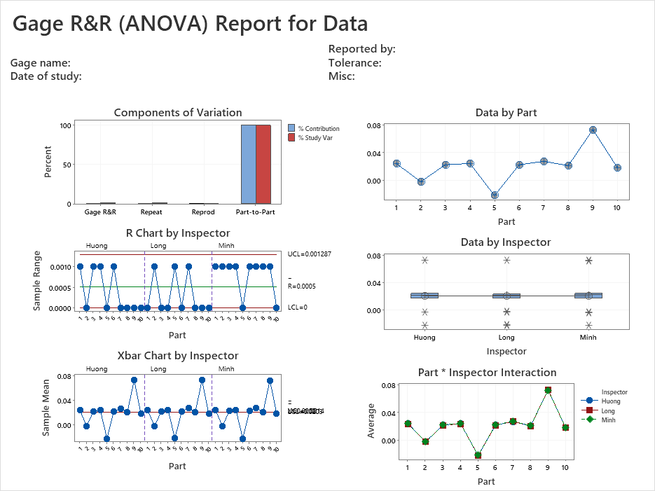
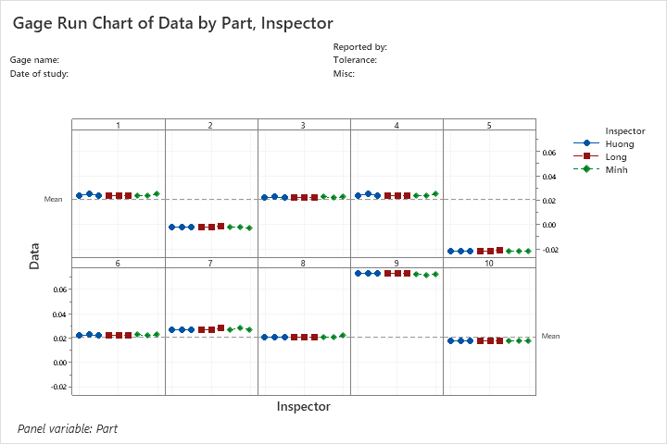
2 Result of Gage Study
Measure
Define
Analyze
Improve
Control
2.2 Type 2 study
Conclusion:
Based on interaction between samples and inspector, we cannot see significant differences between 10 samples.
Inspector’s skill is acceptable. There is no significant differences between 3 operators during each measurement time.

Slide 10
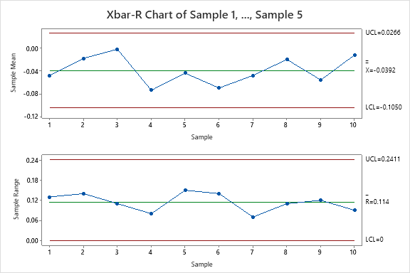
2 Result of Gage Study
Measure
Define
Analyze
Improve
Control
2.3 Xbar-R Chart Review
Issue Name: Flush data
Spec: -0.4 ~ 0mm
Inspection Period: 01-06-2025 ~ 30-06-2025
Date | Sample 1 | Sample 2 | Sample 3 | Sample 4 | Sample 5
1-Jun | -0.12 | 0 | -0.06 | 0.01 | -0.07
2-Jun | 0.01 | -0.11 | 0.03 | 0.02 | -0.04
3-Jun | -0.01 | -0.05 | 0.03 | -0.04 | 0.06
4-Jun | -0.04 | -0.05 | -0.07 | -0.09 | -0.12
5-Jun | -0.11 | -0.03 | 0.04 | -0.05 | -0.07
6-Jun | -0.1 | -0.02 | -0.09 | 0 | -0.14
7-Jun | -0.02 | -0.05 | -0.04 | -0.04 | -0.09
8-Jun | 0 | -0.01 | 0.03 | -0.04 | -0.08
9-Jun | 0.01 | -0.05 | -0.07 | -0.11 | -0.06
10-Jun | -0.02 | -0.03 | 0 | 0.04 | -0.05
Sampling method :
Rational sub group sampling
5ea/line /day/at LG line
Conclusion:
- Based on X-bar R- chart result we can see process is stable
Notes:
Variances are subject to quality control and improvements !!!
1. How to process Type I? We need to measure 30 times for one sample which reference value is known
How to choose Sampling? Chọn mẫu như thế nào? Just choose random sample and know the reference value-
1 mẫu ngẫu nhiên biết trước reference value
2. How to get the reference value? Làm sao để có reference value?
There are two ways: Hai cách:
- First: Use equipment has high precision (accuracy) Sử dụng thiết bị đo chính xác cao.
- Second: Measure one sample 10 times with equipment has high precision then get mean (average) of these measured values. Đo lặp lại part 10 lần với 1 dụng cụ đo chính xác, sau đó lấy trung bình
3. Cg, Cgk là gì? Cg and Cgk are Measuring capacity index of measuring equipment --- Chỉ số năng lực đo đạc của thiết bị đo Tiêu chuẩn: Cg, Cgk >=1.33 4.
Phân biệt giữa Cg vs Cgk? Cg is used when target and data mean are the same, Cgk is used in case target and data mean is not the same.
5. Công thức của Cg &Cgk? Cp and Cpk are called Process Capability. Pp and Ppk are called Process Performance The index takes into consideration the fact that your data is maybe not centered.
How many method to select sample? Simple random Stratified Systematic Cluster Combination Tiêu chuẩn resolution <5% lấy đâu ra? –Based on the standard of GM, Bosch, VDA 5 The acceptance criteria are less than 5% in GM, Bosch, … and less than 10% in AIAG, so the resolution of the instrument is satisfactory. Tolerance=T=USL-LSL %RE=RE/T

Slide 11
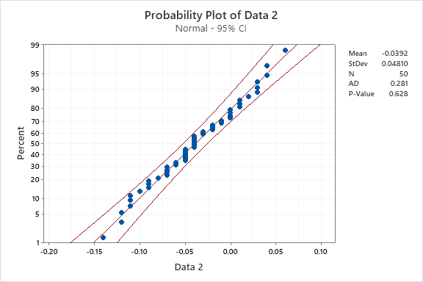
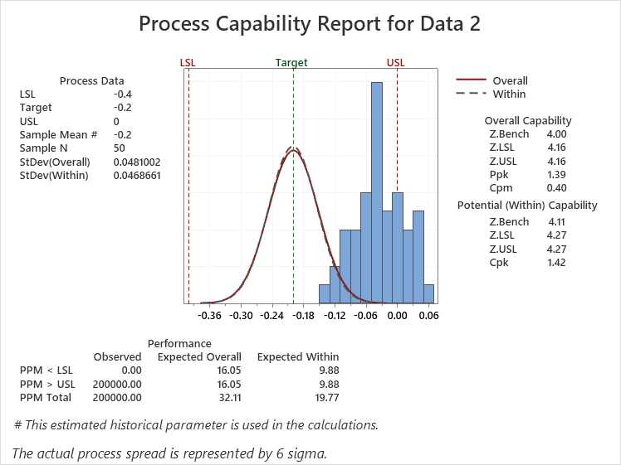
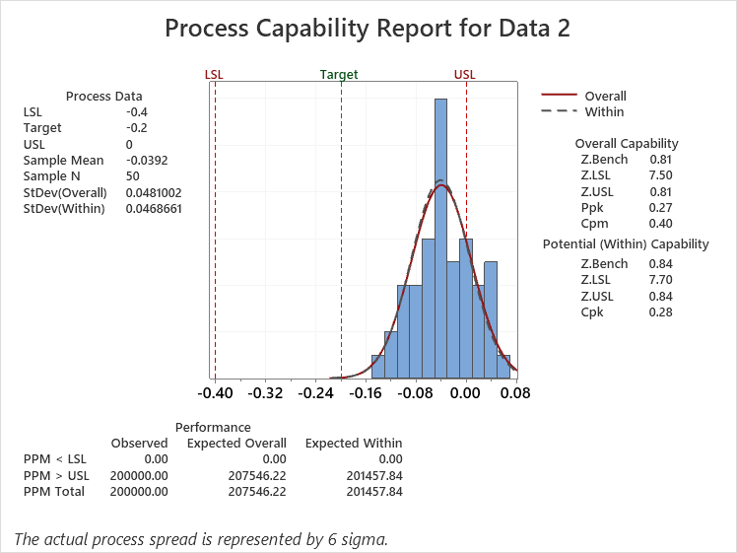
2 Result of Gage Study
Measure
Define
Analyze
Improve
Control
2.4 Result of current Cpk
Current Cpk
P-value = 0.628> 0.05 → OK
(Data follow a normal distribution)
P-value = 0.628> 0.05 → OK
(Data follow a normal distribution)
Target of improvement
Improvement Goals (Practical)
Increase height between LCD and Panel main
(Before improvement) Zst= 0.84 → (after improvement) Flawless
⇒ gap betwen height between LCD and Panel main is center value
Target(Mean)=0(LSL) + 4.5*0.048(std Dev ) = 0.216 (-)
Z level
Defect rate (ppm)
Mean
4.5
500,00
ppm
0.216
Cpk = 0.28 → Standard >1.33 → NG
0.84
-0.039
0
Current
Target
Current
Target
Current
Target

Slide 12
3.1 Find the Root Cause that making flush issue
Analyze
Define
Measure
Improve
Control
In order to define root cause and improvement action, I use logic tree to find the root cause.
LCD
Appearance standard
Clean surface of LCD
Material
Double side tape
Thickness NG
Check DST condition

Panel main
Height dimension NG
Check height of panel main

Logic tree analysis
Flush NG
Machine
Pressure machine
Pressure force
Adjust pressure force

Method
Assembly method
Auto matic process
Man is not related
Input set to jig not fully
Other function is OK, only Flush is NG
Not relate to part input
Man
Working skill
Automatic process
Man is not related

: Potential factor

Slide 13
3.1 Find the root cause that making flush issue
Analyze
Define
Measure
Improve
Control
2 Samples T test
No | Potential Factors | What is looking for ? | Tool to identify
1 | Panel main | Flush value change when change height of panel main (2.70 → 2.90 mm) | 2 sample T test
2 | Machine | Flush value change when change Fressing force change (75kgf→ 80kgf) | 2 sample T test
3 | Double side tape | Flush value change when change double side tape attached position | 2 sample T test

: Potential factor
Notes:
Ghi thông số

Slide 14
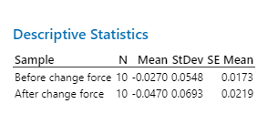
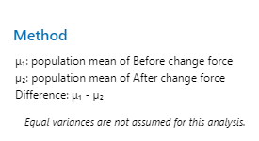
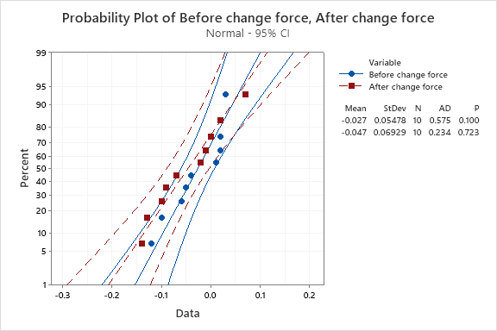
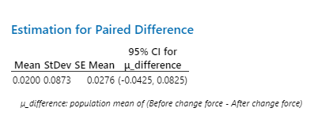

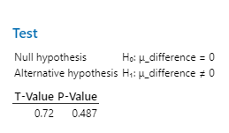
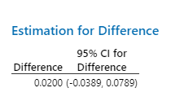
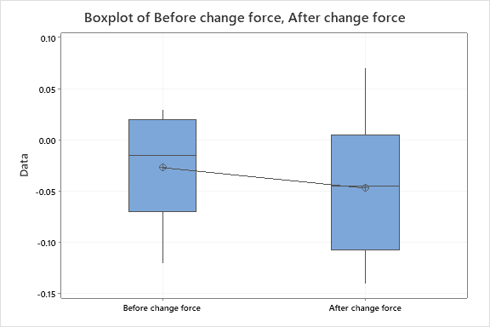
3.1 Find the root cause that making flush issue
Analyze
Define
Measure
Improve
Control
2 Samples T _ Analysis
Check pressure force value before/after change height of panel main (75kgf.cm² →80kgf.cm²)
H0: Changing the pressure force of machine not effect to flush
H1: Changing the pressure force of machine effect to flush
Since the P-Value before and after the changing pressure force are normally distributed
Since the P-Value value is greater than 0.05, the variances of the two data cannot be considered homogeneous _ they cannot be considered different from each other

Slide 15
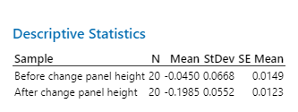
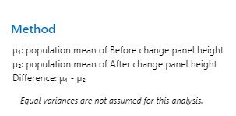
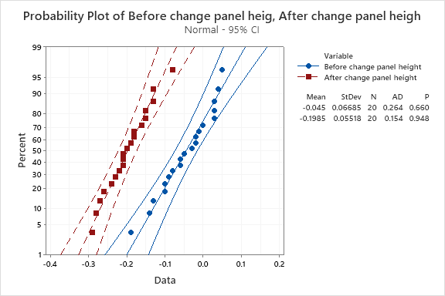
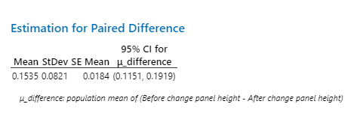
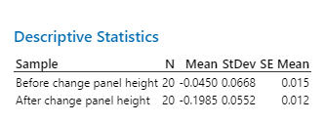

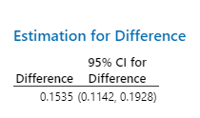
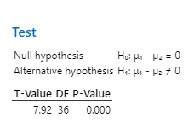
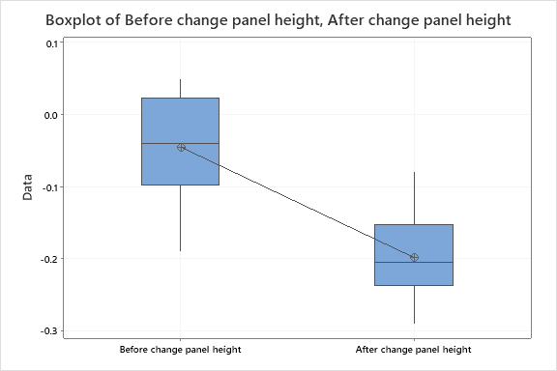
3.1 Find the root cause that making flush issue
Analyze
Define
Measure
Improve
Control
2 Samples T _ Analysis
Check flush value before/after change height of panel main 2.72mm → 2.90mm
H0: Changing the height of panel main not effect to flush
H1: Changing the height of panel effect to flush
Since the P-Value before and after the changing pressure force are normally distributed
Since the P-Value value is less than 0.05, the variances of the two data can be considered homogeneous _ they can be considered different from each other

: Potential factor

Slide 16
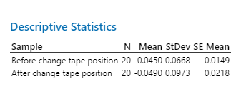
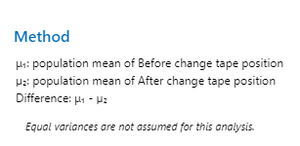
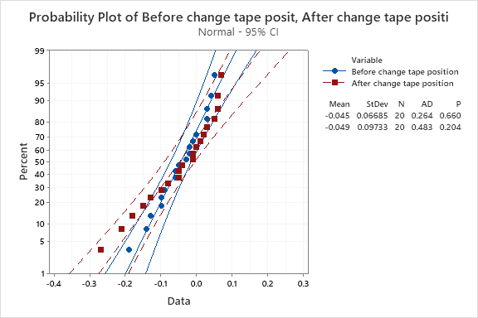
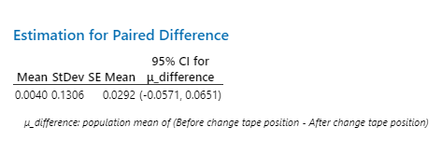
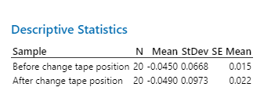



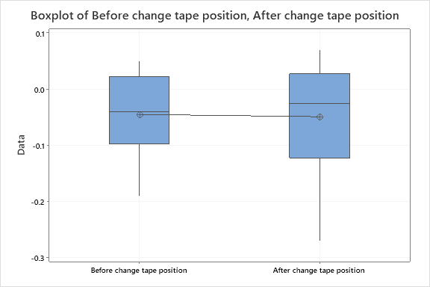
3.1 Find the root cause that making flush issue
Analyze
Define
Measure
Improve
Control
2 Samples T _ Analysis
Check flush value before/after change height of panel main
H0: Changing the tape position not effect to flush
H1: Changing the tape position effect to flush
Since the P-Value before and after the changing pressure force are normally distributed
Since the P-Value value is greater than 0.05, the variances of the two data cannot be considered homogeneous _ they cannot be considered different from each other

Slide 17
3.1 Find the root cause that making flush issue
Analyze
Define
Measure
Improve
Control
2 Samples T test
No | Potential Factors | What is looking for ? | Tool to identify
1 | Panel main | Flush value change when change height of panel main | 2 sample T test
2 | Machine | Flush value change when change Fressing force change | 2 sample T test
3 | Double side tape | Flush value change when change double side tape attached position | 2 sample T test

Conclusion:
After change height of panel main from 2.70 mm to 2.90 mm, mean change from -0.045 to -0.1985 (center value)
→ This factor effect to issue

: Potential factor
Notes:
Add conclusion

Slide 18
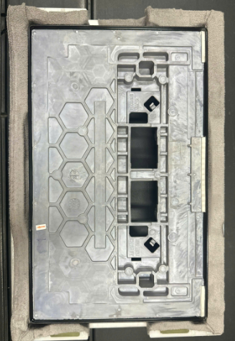
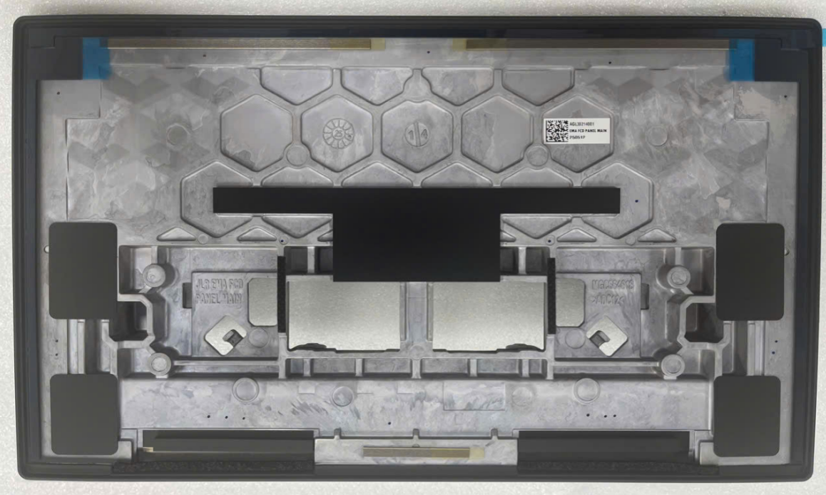
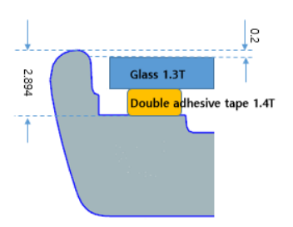
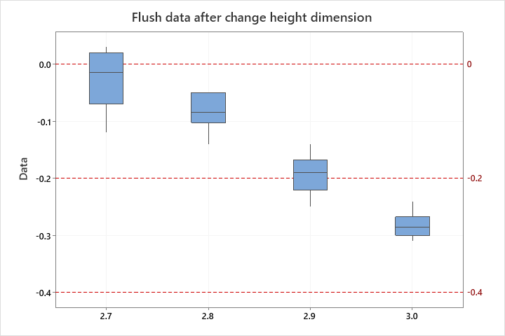
Improve
4. Improvement (short term)
Define
Measure
Analyze
Control
4.1 Improvement height of panel main
Before | After
Base on flush data after change height of panel main 2.7~3.0mm
→ We can see if height of panel main is 2.9, the flush is center value
→ We will adjust height of panel main to 2.9mm
Reduce height of panel main
As is: 2.72

Slide 19
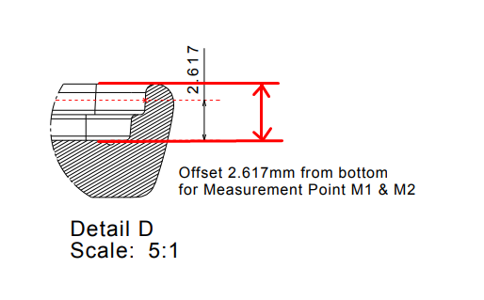
Improve
4. Improvement (long term)
Define
Measure
Analyze
Control
4.2 Add height dimension on drawing to control
Before | After
Panel main not control
Add spec 2.90 in the drawing
2.90 ±0.05

Slide 20
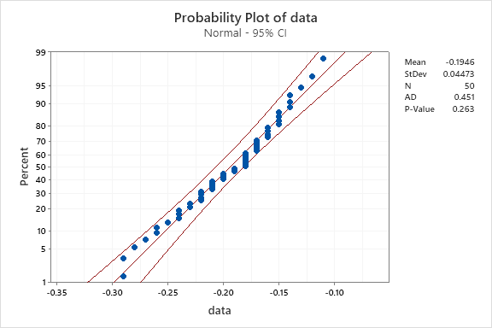
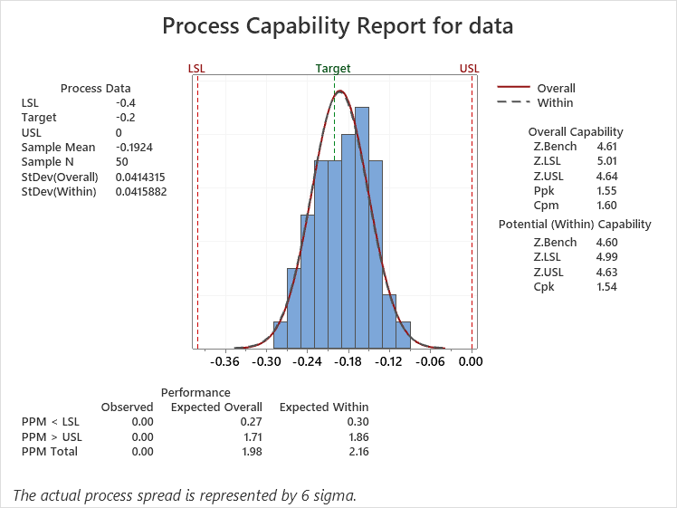
Improve
4. Improvement
Define
Measure
Analyze
Control
4.4 Process Capability review
Before
After
P-value = 0.628> 0.05 → OK
(Data follow a normal distribution)
P-value = 0.263> 0.05 → OK
(Data follow a normal distribution)
Cpk = 0.28 → Standard: ≥ 1.33 → NG
Lack of process capability
Cpk = 1.54 → Standard: ≥ 1.33 → OK
Good process capability

Slide 21
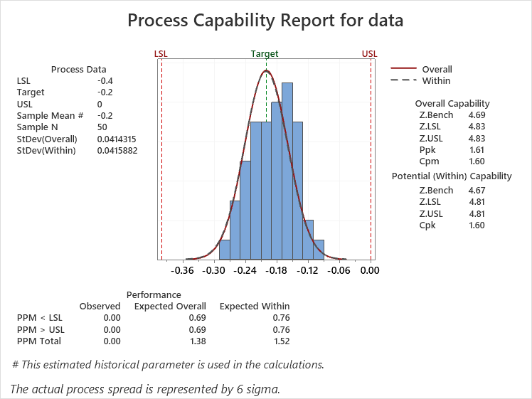
Improve
4. Improvement
Define
Measure
Analyze
Control
4.4 Process Capability review
Check the Z short term (best capability of process) and the Z long term (customer’s perspective):
Zshift = Zst – Zlt = 4.67 – 4.60 = 0.07 → Z shift < 1.5
→ Proper process control management
Z long term : 4.60 ≥ 4.5, Z short term: 4.67 ≥ 4.5
→ Technology is OK

Slide 22
4. Improvement
Define
Measure
Analyze
Improve
Control
4.5 Conclusion
After checking and found out that the height dimension has problems when test sample, we also suspect that the height dimension is the cause of Flush issue
We conducted improving the height dimension by mold modifycation . After that, we also calculated flush data, use Xbar chart to control and Process capability to evaluate result
The result shows that there is no problems with the height dimension after improvement.

Slide 23
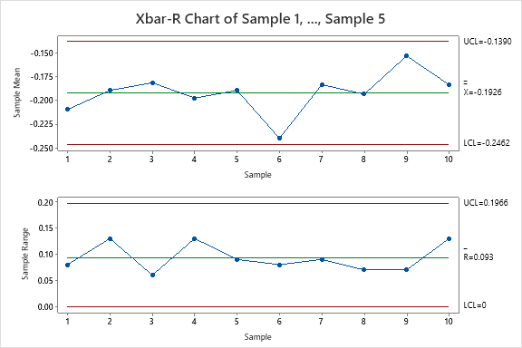
Improve
5. Control
Define
Measure
Analyze
Control
1. Xbar-R Chart Review after improving
To monitor the mean and the variation of process after applying improvement and use control chart to monitor process stability over time.
- Sampling method: Rational sub group sampling firsts 5ea/day at production line for 10 days to analyze:
Date | Sample 1 | Sample 2 | Sample 3 | Sample 4 | Sample 5
1-Jul | -0.22 | -0.16 | -0.21 | -0.24 | -0.22
2-Jul | -0.2 | -0.17 | -0.12 | -0.25 | -0.21
3-Jul | -0.17 | -0.16 | -0.19 | -0.17 | -0.22
4-Jul | -0.14 | -0.2 | -0.13 | -0.26 | -0.26
5-Jul | -0.18 | -0.16 | -0.22 | -0.24 | -0.15
6-Jul | -0.22 | -0.23 | -0.21 | -0.25 | -0.29
7-Jul | -0.18 | -0.24 | -0.18 | -0.17 | -0.15
8-Jul | -0.21 | -0.18 | -0.16 | -0.19 | -0.23
9-Jul | -0.11 | -0.15 | -0.18 | -0.18 | -0.15
10-Jul | -0.27 | -0.14 | -0.17 | -0.14 | -0.2
Conclusion:
No abnormality can be found in the Xbar control chart and the R control chart. Therefore, stability is acceptable, the performance of process over time is Good

Slide 24
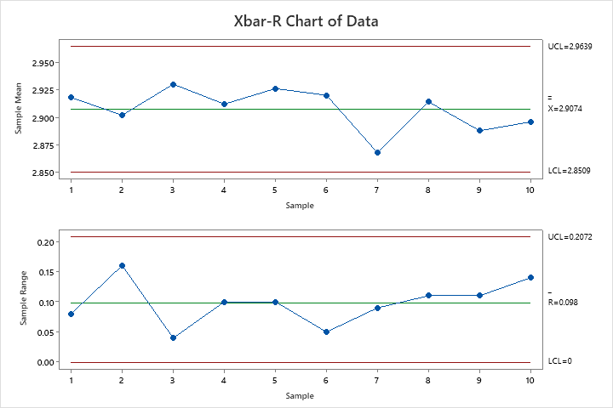
Improve
5. Control
Define
Measure
Analyze
Control
2. Xbar-R Chart Review after improving the measurement system
To monitor the mean and the variation of process after applying improvement and use control chart to monitor process stability over time.
- Sampling method: Rational sub group sampling firsts 5ea/day at production line for 10 days to analyze:
Date | Sample 1 | Sample 2 | Sample 3 | Sample 4 | Sample 5
1-Jul | 2.88 | 2.94 | 2.89 | 2.86 | 2.88
2-Jul | 2.9 | 2.93 | 2.98 | 2.85 | 2.89
3-Jul | 2.93 | 2.94 | 2.91 | 2.93 | 2.88
4-Jul | 2.96 | 2.9 | 2.97 | 2.84 | 2.84
5-Jul | 2.92 | 2.94 | 2.88 | 2.86 | 2.95
6-Jul | 2.88 | 2.87 | 2.89 | 2.85 | 2.81
7-Jul | 2.92 | 2.86 | 2.92 | 2.93 | 2.95
8-Jul | 2.89 | 2.92 | 2.94 | 2.91 | 2.87
9-Jul | 2.99 | 2.95 | 2.92 | 2.92 | 2.95
10-Jul | 2.83 | 2.96 | 2.93 | 2.96 | 2.9
Conclusion:
No abnormality can be found in the Xbar control chart and the R control chart. Therefore, stability is acceptable, the performance of process over time is Good

Slide 25
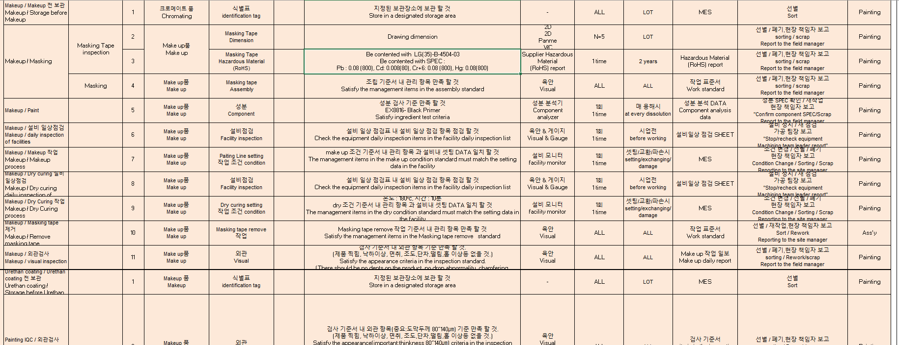
2. Future plan
Define
Measure
Analyze
Improve
Control
Management plan
Supplier add height dimension to control after completed painting process(update on PPAP document)

Slide 26
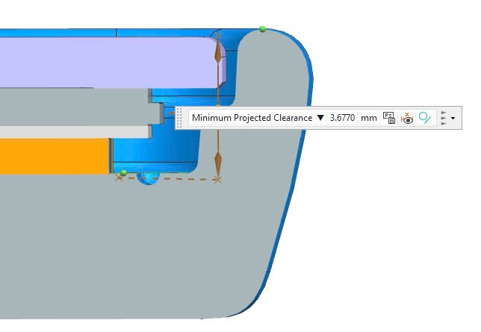
1.Result of project
Control
Define
Measure
Analyze
Improve
Model: JLR EMA FCD
Part name: Control height of panel main
Quantitative Performance (Compare with target)
Qualitative Performance(Compare with target)
1. Improve issue completely, no more same defect happens
2. Lesson learn, update in issue list, review when new similar project in development to prevent similar defect of other models in advance
Before defect rate: 500,529 ppm
→ EST: Change new ATO and panel main ( 70$)
After defect rate: 0 ppm → Improve issue
Total save cost= 70$ * 500 EA= 35000 $
Height/Flush Defect Rate (ea)
NG
OK
↓100%
Before
After
(June)
Summary Defect rate of EMA FCD after improvement
 | Before |  |  | After
Date | 15.May | 18.May | 22.May | 12.June | 16.June | 18.June
Total NG | 50 | 20 | 12 | 0 | 0 | 0
Prod Q'ty | 138 | 47 | 60 | 20 | 30 | 200
Defect rate (ppm) | 362,319 | 425,532 | 200,000 | 0 | 0 | 0

